Slide 1
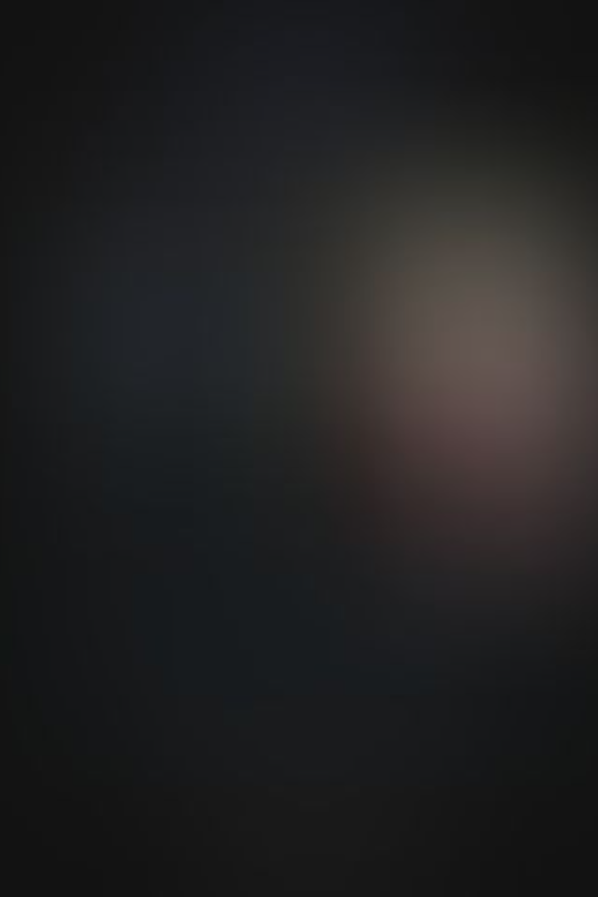
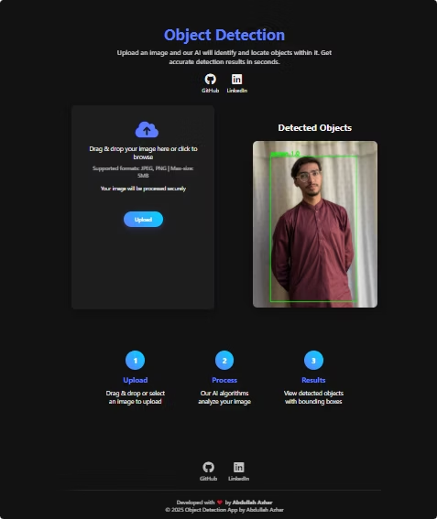

Flask Web Application with YOLOv3 Object Detection
This presentation my project realted to , Flask app integrating YOLOv3 for real-time object detection.
Exploring frontend design, backend logic, and sample detection results.
Project by Abdullah Azhar

Slide 2

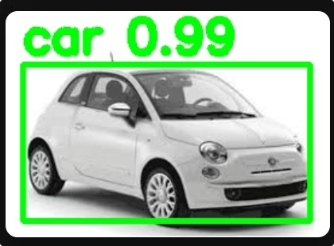



Application Purpose & Goals
Real-time Object Detection
Accessible Web Interface
Identify multiple objects in images .
Allow users to upload images and visualize detections easily.
Developer Friendly
Designed for extension and experimentation with models.

Slide 3
Frontend Design: HTML & CSS
Result Display Area
Image Upload Form
Shows processed image with bounding boxes overlayed dynamically.
Simple input field to submit images via POST requests.

Slide 4

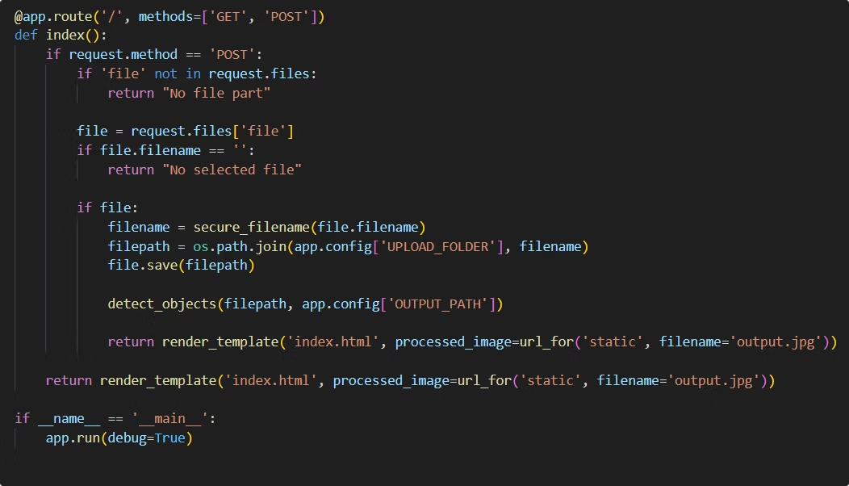

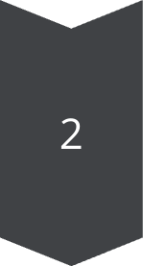
Backend Implementation
Flask API Routes
Endpoint for image uploads
Route serving detection results
YOLOv3 Integration
Load pre-trained weights and config
Process images and generate bounding boxes

Slide 5

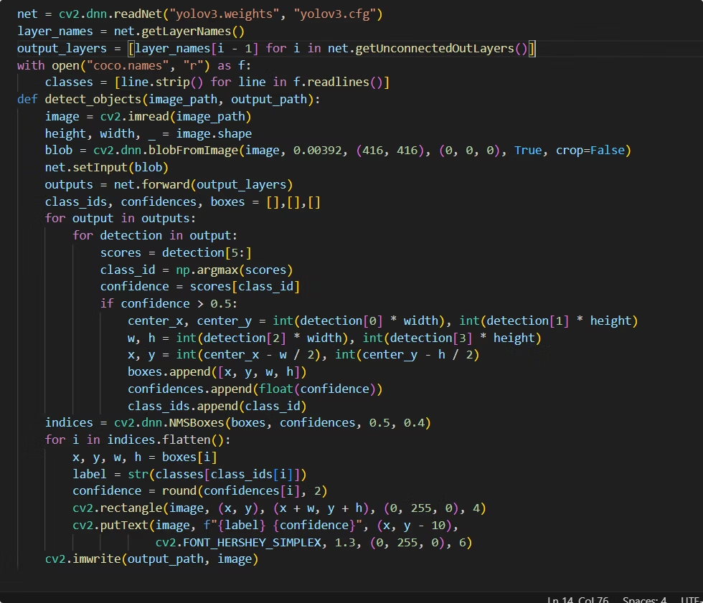

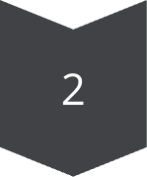
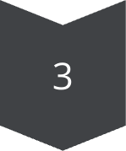
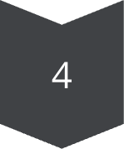
YOLOv3 Detection Pipeline
Input Processing
Resize and normalize incoming images for the model.
Feature Extraction
Use Darknet-53 backbone to extract deep features.
Bounding Box Prediction
Detect objects and calculate confidence scores.
Non-Max Suppression
Filter overlapping boxes for clean final results.

Slide 6
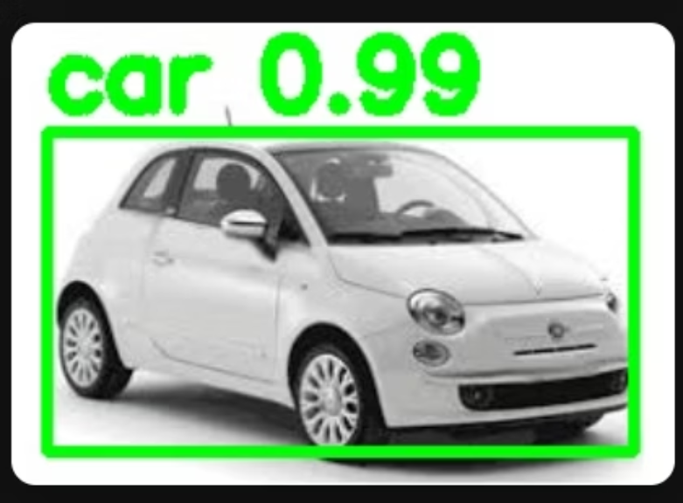
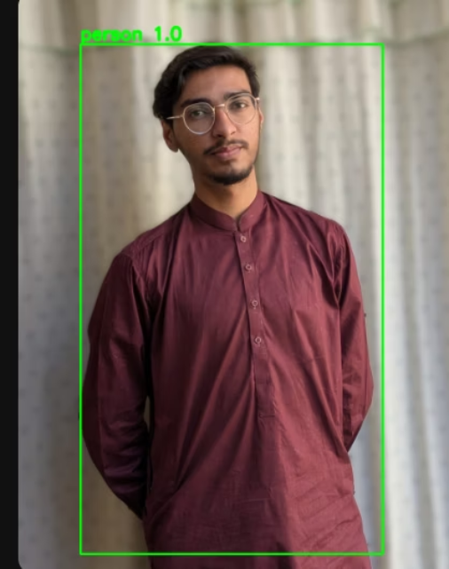
Sample Outputs with Bounding Boxes
1
2
Vehicle Detection
Bounding boxes highlight detected cars accurately.
Person Tracking
People identified consistently with high confidence.

Slide 7

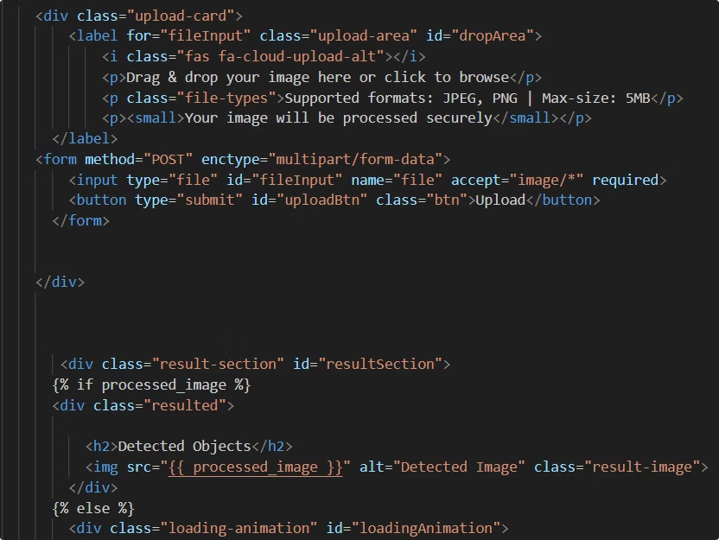
Performance & Scalability Considerations
Model Optimization
Asynchronous Processing
Use YOLO v3 or Latest , optimized version for speed.
Handle requests without blocking using background tasks.

Slide 8



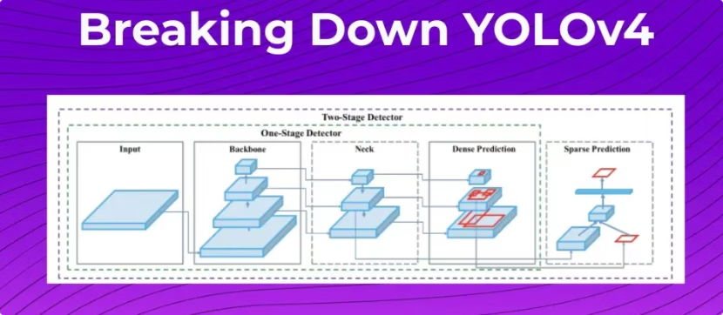

Next Steps & Resources
Extend Model Support
Enhance UI
Improve frontend with React JS for dynamic feedback.
Add other architectures like YOLOv4 or EfficientDet.
Explore Datasets
Train custom models with COCO or Open Images datasets.
Leverage community resources and documentation to accelerate development.

